Slide 1

ML PROJECT WITH NEPTUNE
Group KHMT1-04

Slide 2

MEMBERS
21127063
21127089
21127183
21127528
Nguyen Van Dang Huynh
Nguyen Tuan Kiet
Pham Phu Toan
Nguyen Thi Minh Minh
Group KHMT1-04

Slide 3
Table of contents
01
02
03
04
05
06
INTRODUCTION
COMPONENTS
CONCEPTIONS AND FUNCTIONS
COMPARISON
DEMO
POPULARITY & CASES

Slide 4
01
INTRODUCTION

Slide 5


Brief history – The problem
The teams of scientists - Neptune AI's production team - struggled to track and share their work results
Work Sharing
Tracking

Slide 6

Brief history – The solution
Data scientists worldwide faced similar challenges, losing their work results daily
Motivated the Neptune production team to create a solution available to all – Neptune AI

Slide 7
Brief history
2017
2018
2023 - Beyond
Initially used internally
within deepsense.ai’s
services in 2017.
Spin off as a Startup - Focus on creating a tool that is lightweight and easy to use.
Neptune AI is continually evolving and integrating

Slide 8
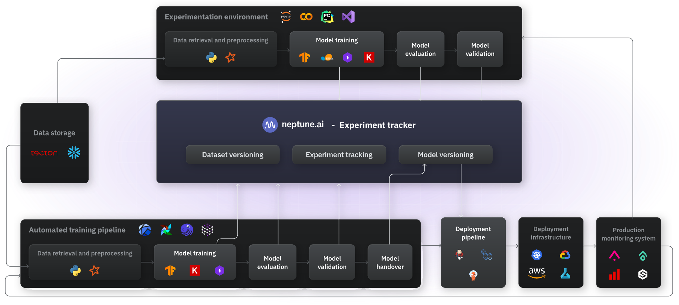
NEPTUNE

Slide 9
02
COMPONENTS

Slide 10
COMPONENS
Web Application
Python API

Slide 11
Web App
Data versioning
The web app is your UI to the logged metadata. It's where you can have the data visualized, sorted, and organized.
You can watch the training live and, if needed, stop runs remotely. You can also browse tracebacks, system metrics, and source code.
Experiment tracking
Model registry

Slide 12
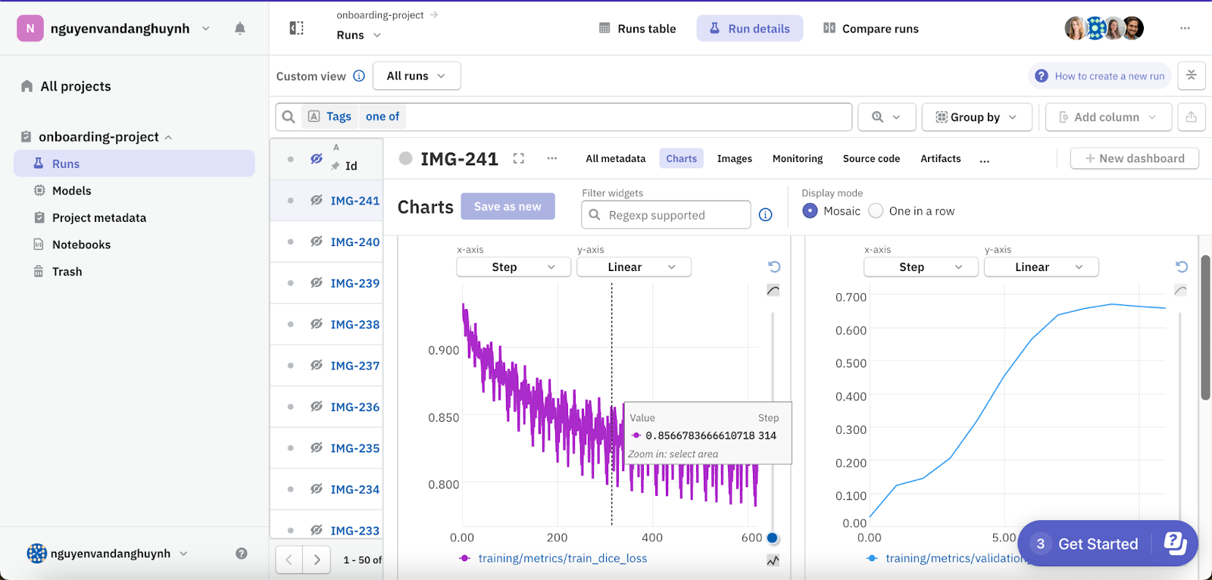
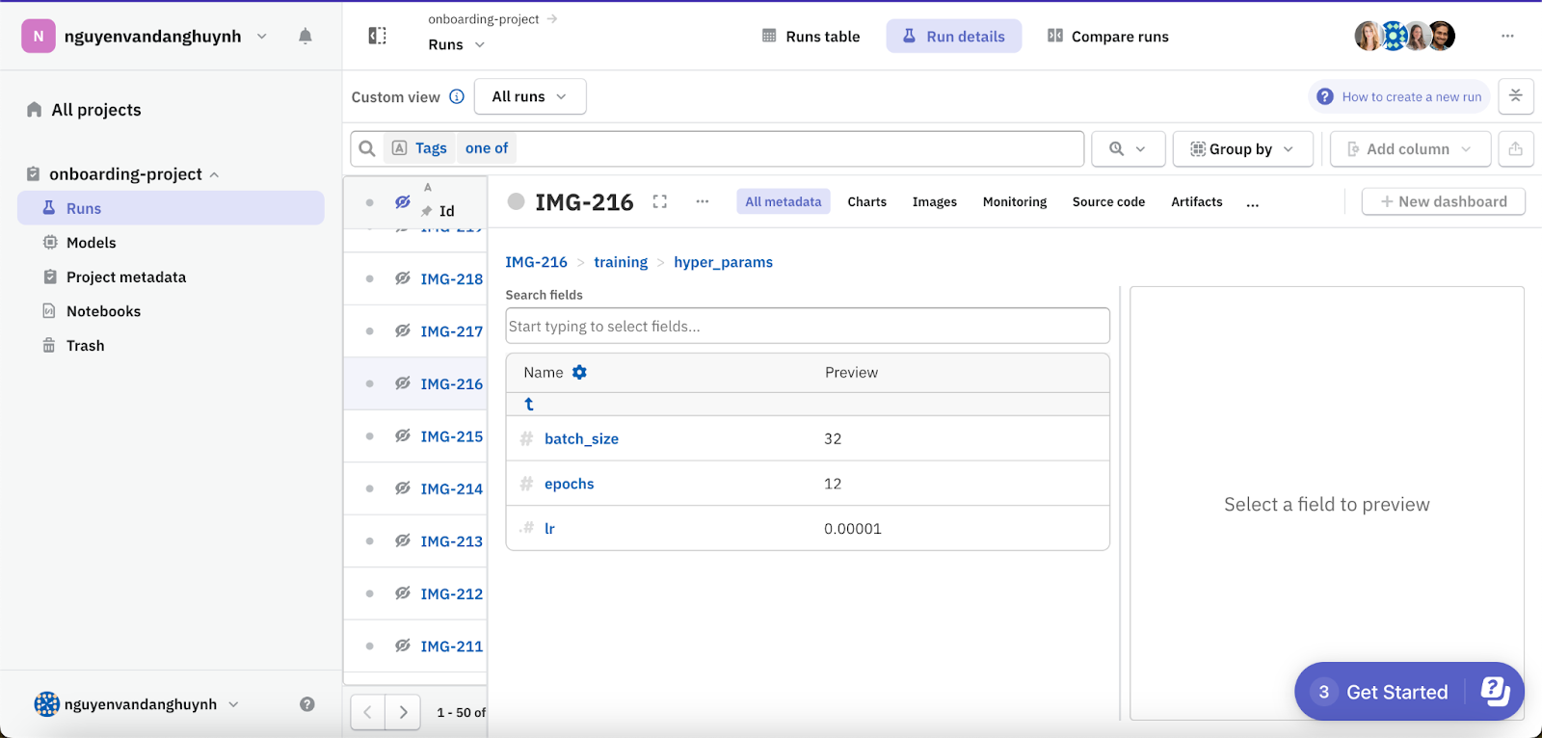
Web Application – Data versioning
Log hyperparameters
Log metrics

Slide 13
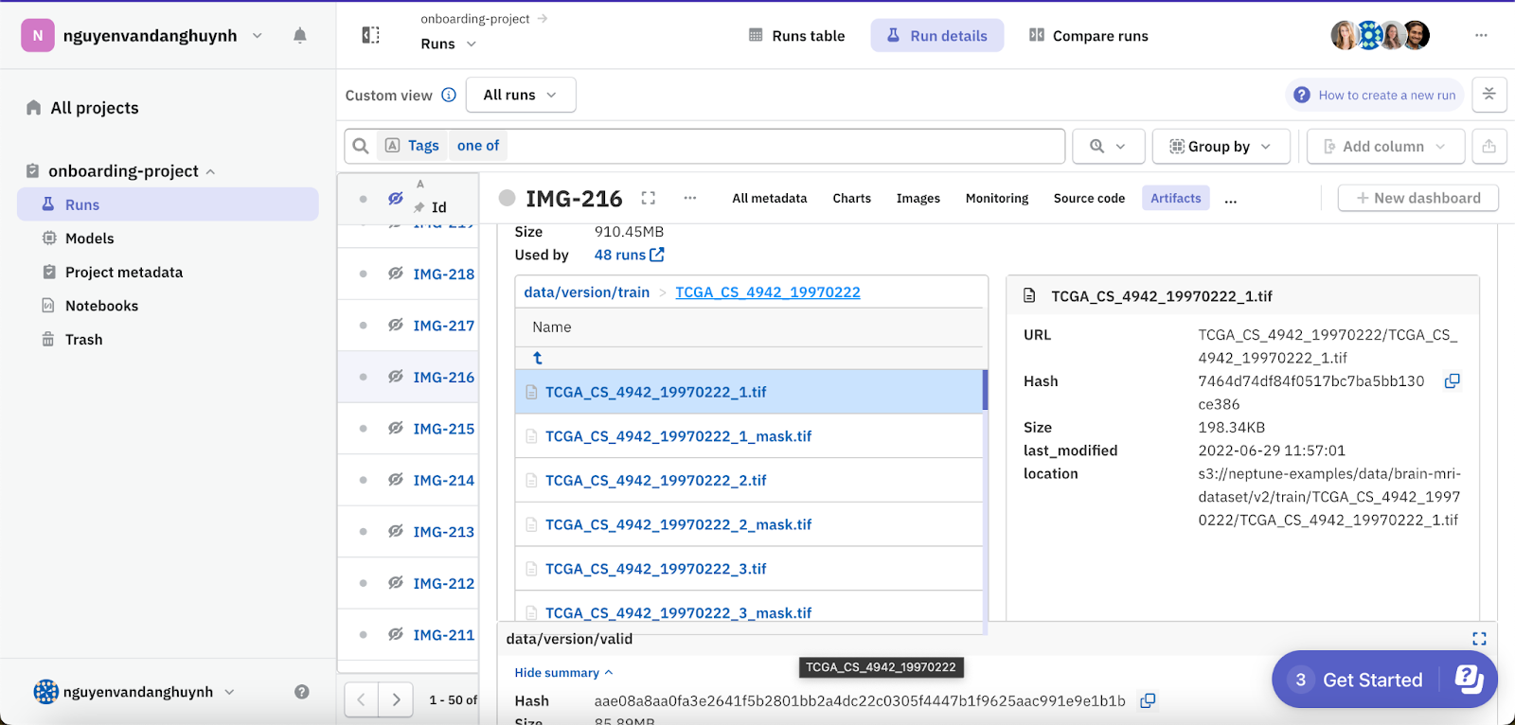
Web Application – Data versioning
Log data and model versions

Slide 14
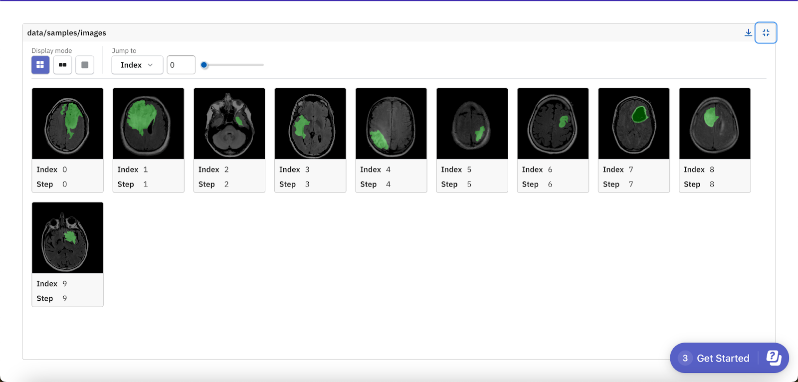
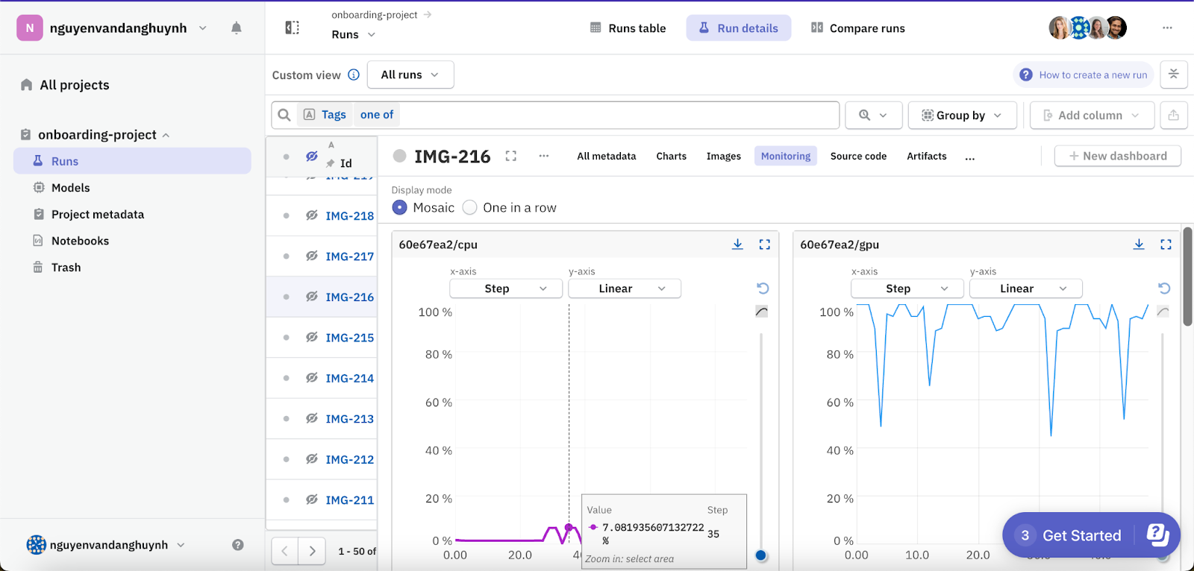
Web Application – Data versioning
Log hardware
Log images

Slide 15
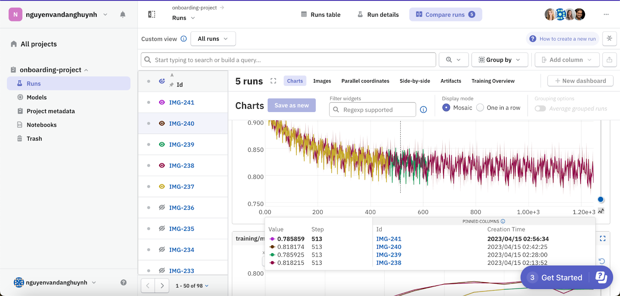
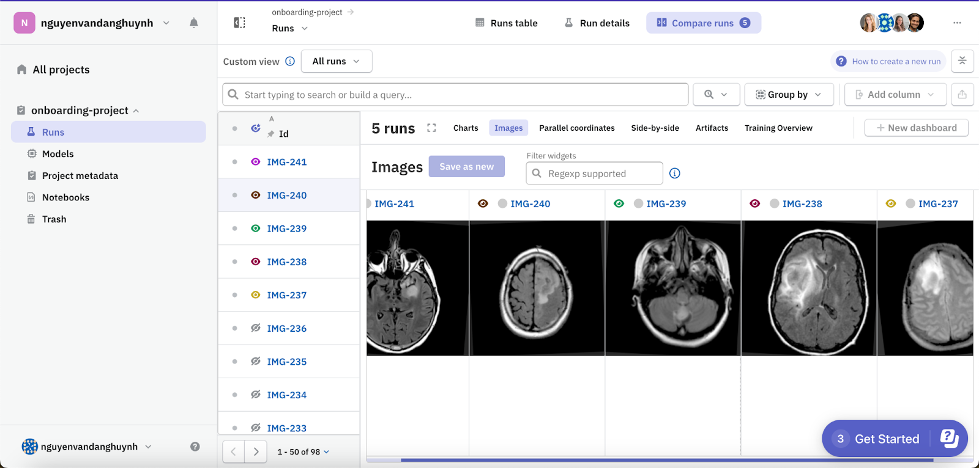
Web Application – Experiment tracking
Compare charts
Compare images

Slide 16
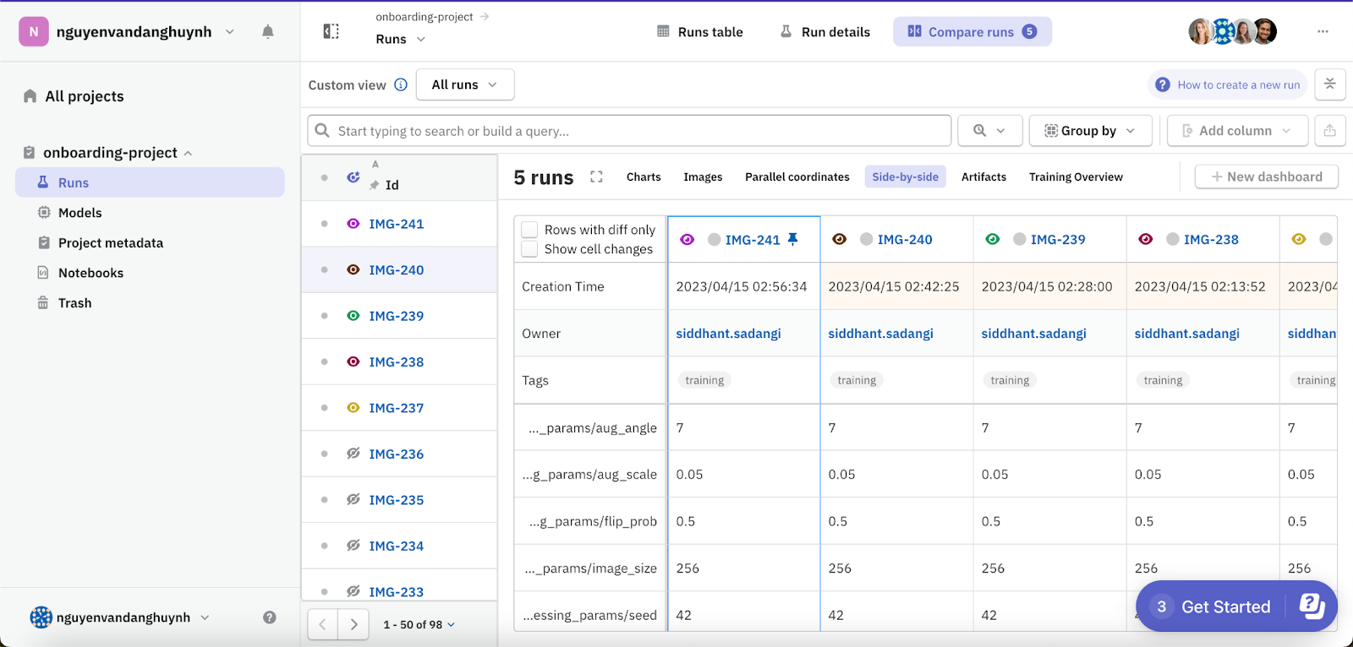
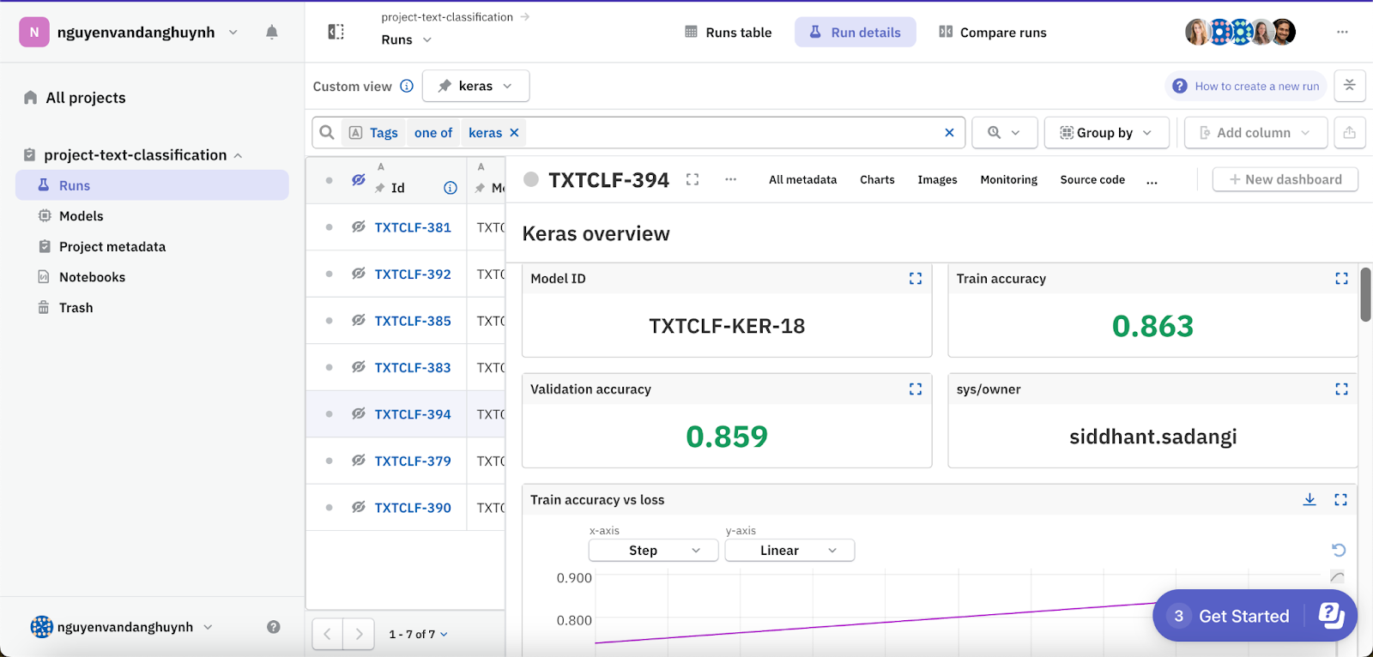
Web Application – Experiment tracking
Experiments visualized in dashboard
Compare side-by-side

Slide 17
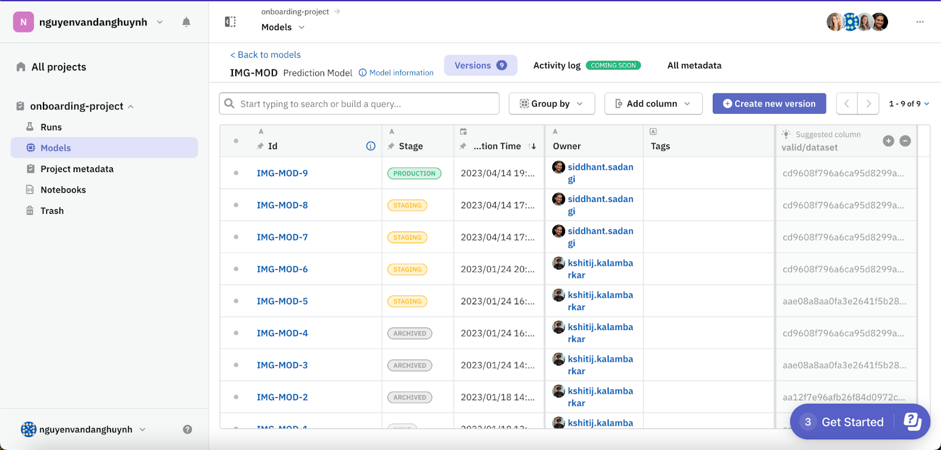
Web Application – Model registry
Model versions

Slide 18
Python API
Neptune client library
Integration

Slide 19

Python API - Neptune client library
The Neptune client library (Neptune API) is an open source suite of libraries to help you log, query, and download model-building metadata. You can also use the Neptune API to manage projects, users, and model stages.
The API is lightweight and designed to integrate with your MLOps tech stack in a flexible manner.
Neptune CLI
The Neptune client library comes with a command-line interface (CLI) tool.
You can use Neptune CLI to locally manage the synchronization of your data with Neptune servers, which comes in handy if you have data that's only stored locally (for example, if you experience connectivity issues).

Slide 20
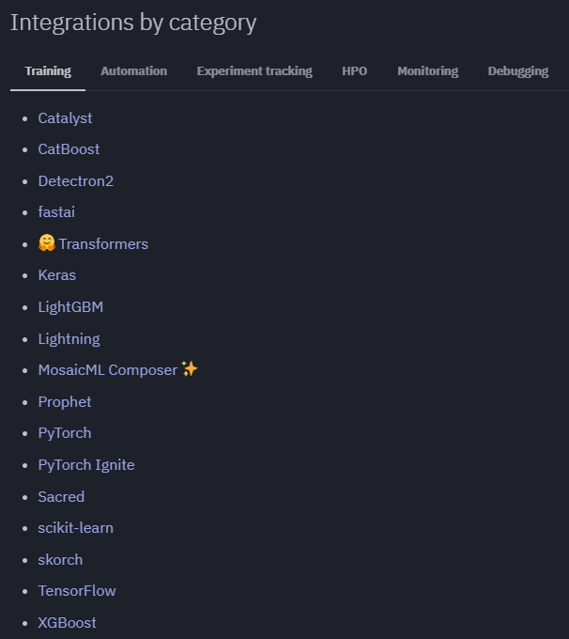
Python API - Integration
Neptune integrates with various machine learning libraries.
Most integrations are implemented as loggers or callbacks that you pass along in your model training code.

Slide 21
03
CONCEPTIONS & FUNCTIONS

Slide 22
First look
Space where you can manage projects, people, and your subscription
Workspace
Neptune
Like a password to the application.
Help to identify people inside Neptune.
Neptune API token

Slide 23
The main objects inside a workspace
Project
Represent for a project in real life. One project can contain many runs and models.
Model:
Represent for you ML model. A model is a collection of metadata common to all versions of a model you're working on.
Run
Object containing model-building metadata. A run created every time we run script training models.

Slide 24
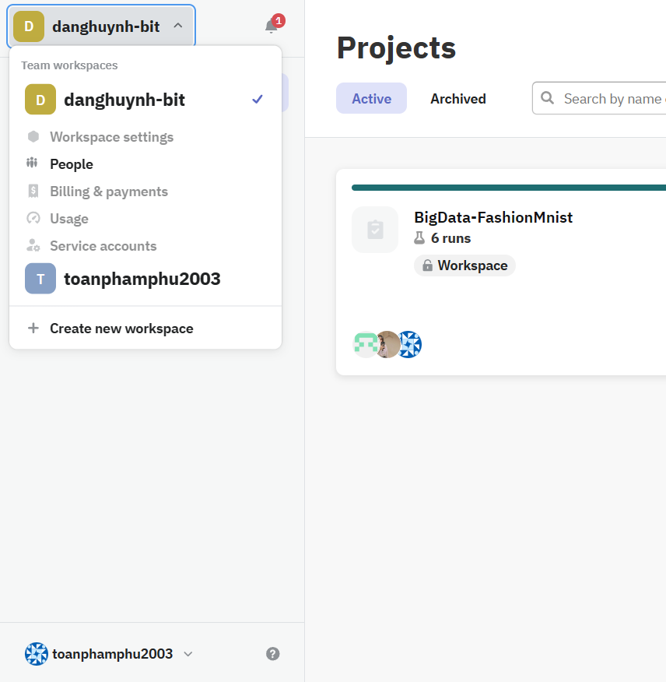
Project Object
Projects have three levels of visibility:
+ Workspace: Any workspace member can access these projects.
+ Public: Freely available to view by anyone on the internet.
+ Private: Only users assigned to the project can see it.

Slide 25
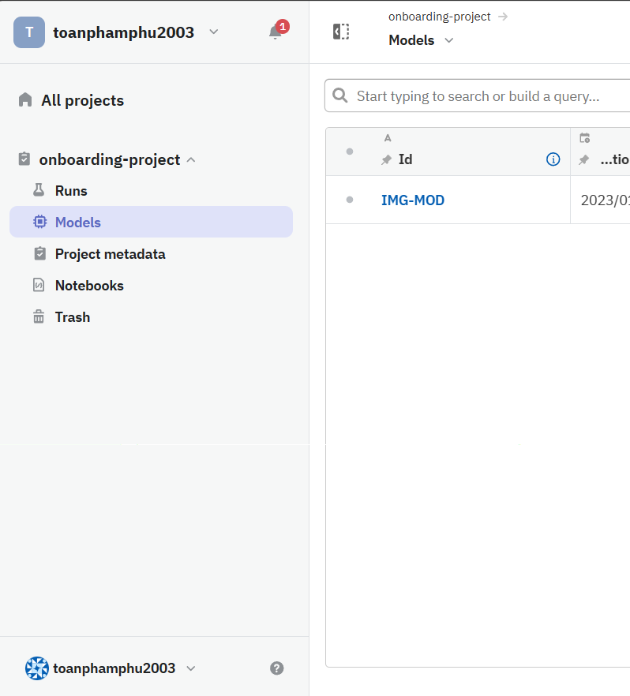

Model Object
Each model in Neptune can consists of many Model Versions: Collection of metadata specific to a version of a model.

Slide 26
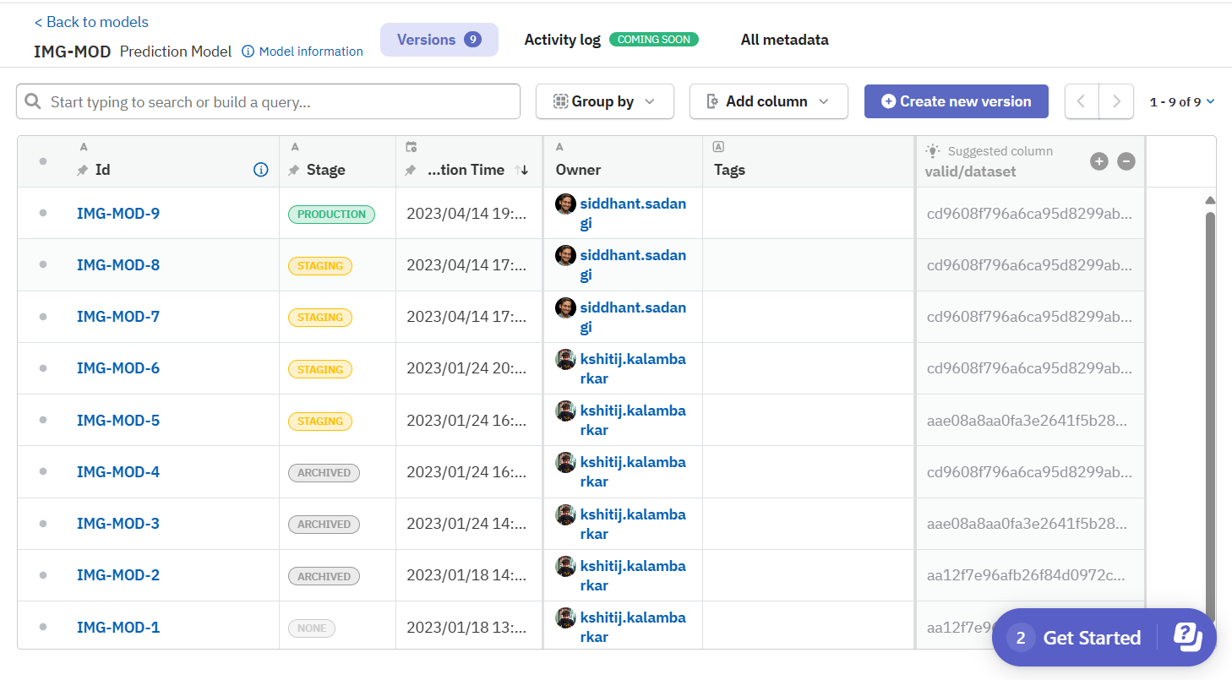

Model Version

Slide 27
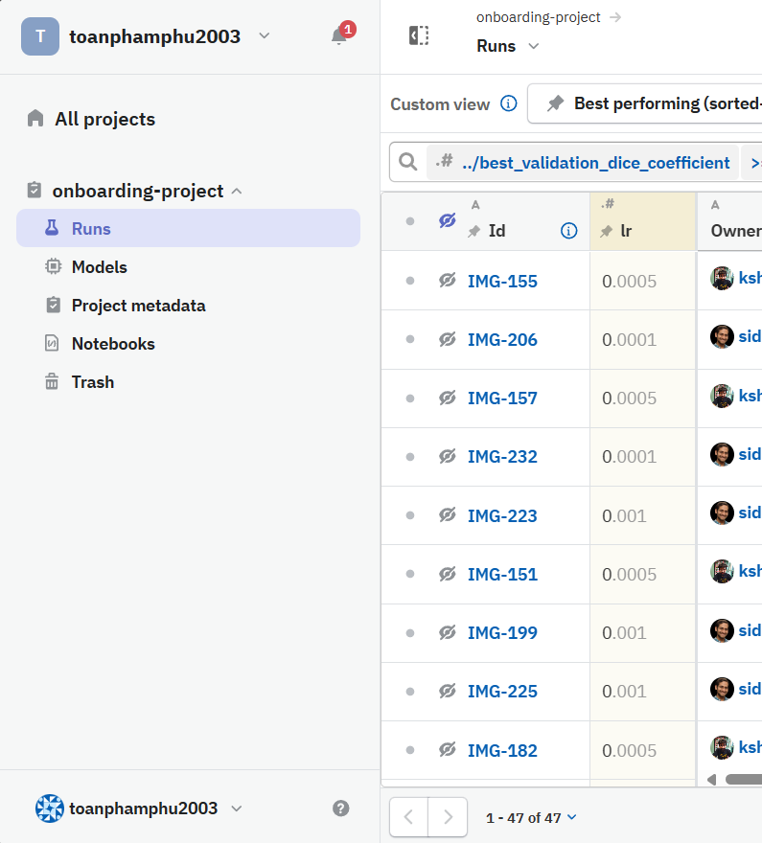
Run Object
Represent for the the experiment in real life. With each run, Neptune help you visualize, easily search and also make comparison among runs.

Slide 28
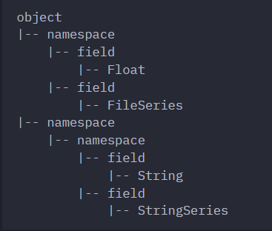
Organization of metadata to be logged
A folder-like structure for the metadata

Slide 29
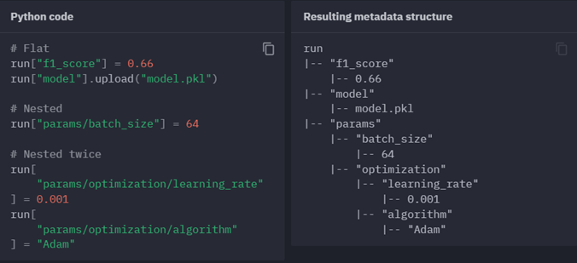
Organization of metadata to be logged

Slide 30
The metadata to be automatically logged
Source code
The following source files are logged in the source_code namespace:
entrypoint: filename of the script you executed, like main.py
files: the content of the script you executed.
Git information
Neptune extracts some information from the .git directory.
System information
Basic metadata about initialized Neptune objects, such as their identifier (ID), running time, and size, inside sys namespace
Hardware consumption
Logged in the monitoring namespace: cpu, memory, gpu, gpu_memory
Console logs
Console logs (or standard streams) are also logged in the monitoring namespace.

Slide 31

And the other metadata, which defined by yourself

Slide 32

The type of metadata
You can log what ever you want, Neptune supports almost the type of data. It can be a file, a folder, or just the field with a number or string, etc.
One special type of metadata in Neptune: Artifact
It use specific APIs <track_file()>.
Besides uploading the data, Neptune also include some extra information to track and version them in Neptune

Slide 33
Functions provided
Collaborate
Visualize
Comparing
Monitor training
Model/data versioning
Reproduce experiments

Slide 34
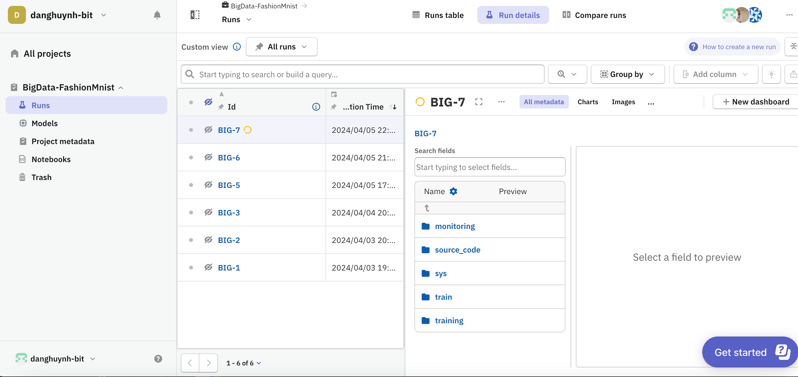
Collaborate

Slide 35
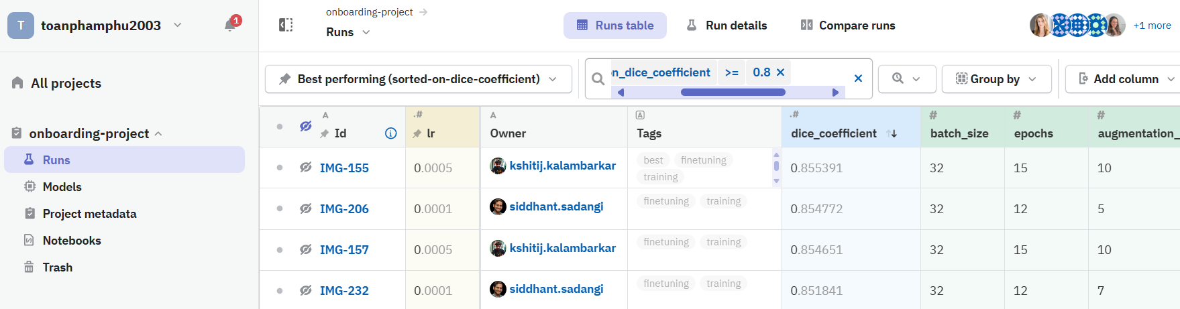
Visualize

Slide 36
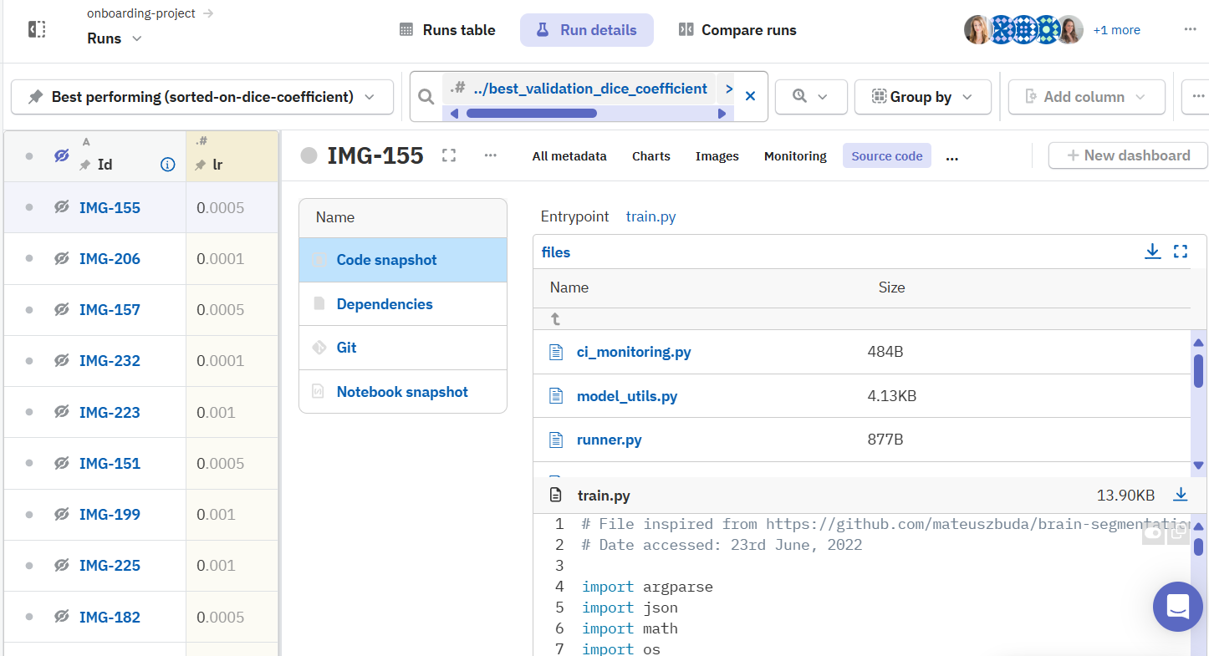
Visualize

Slide 37
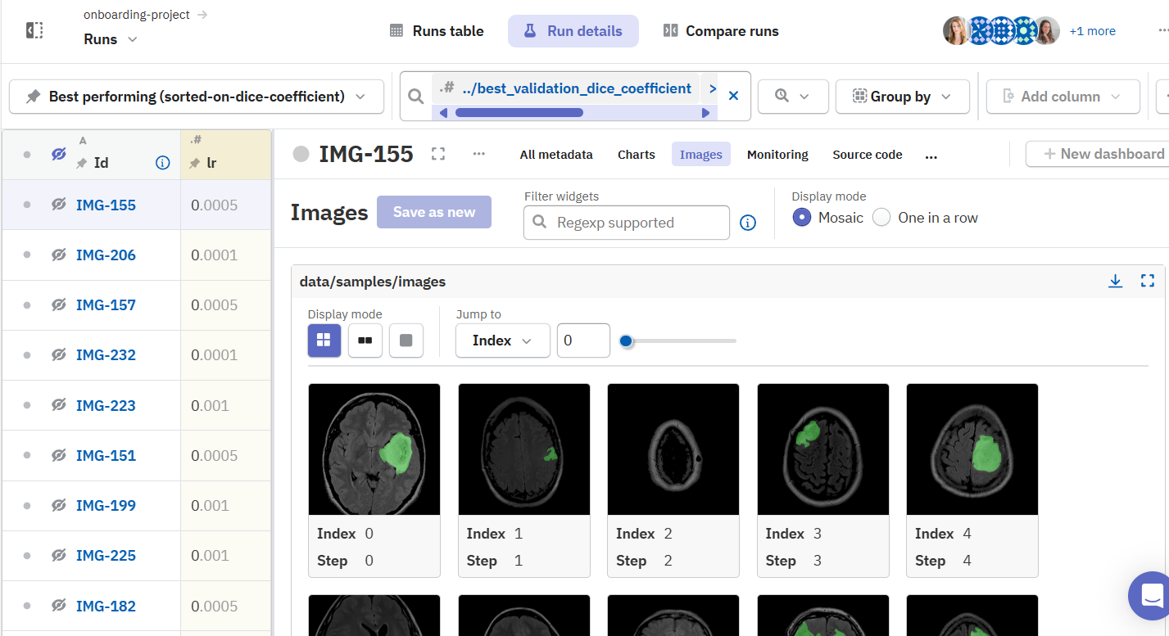
Visualize

Slide 38
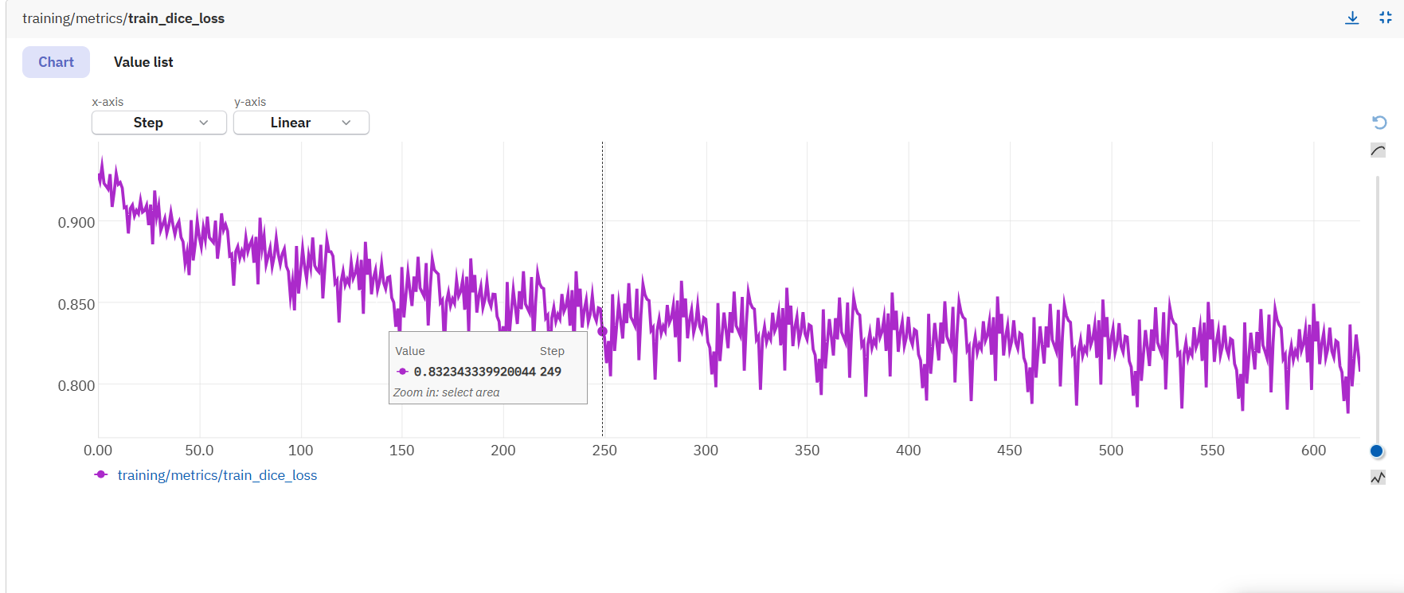
Visualize

Slide 39
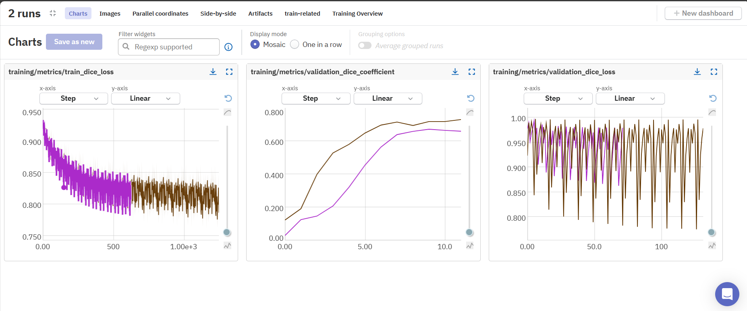
Comparing

Slide 40
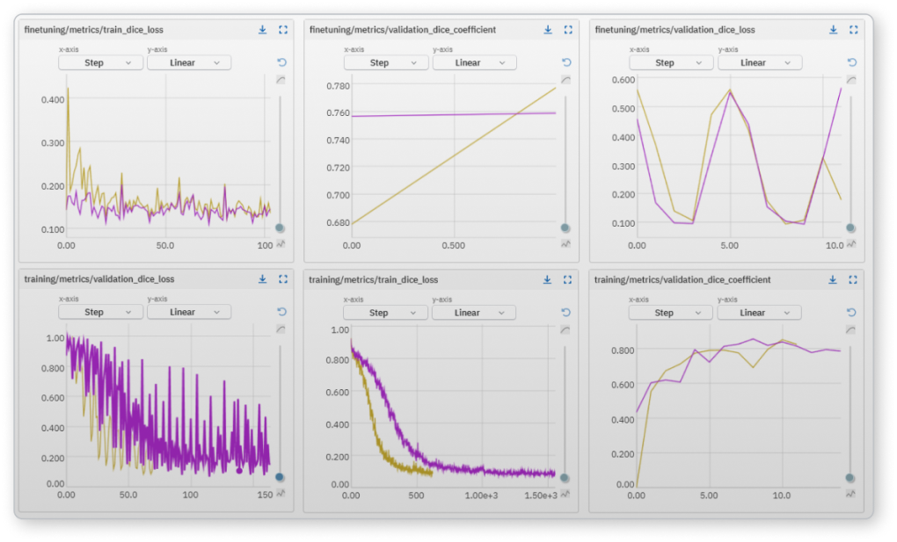
Monitor training
Get insight of your training from a live feed

Slide 41
Model/data versioning
Reproduce experiments
Metadata

Slide 42
Some little things
“Notebooks” object
The object for storing notes, some extra information define by user.
Where Neptune stores your data
With the default plan, your metadata will be store in the neptune server which is hosted on Google Cloud Platform.

Slide 43
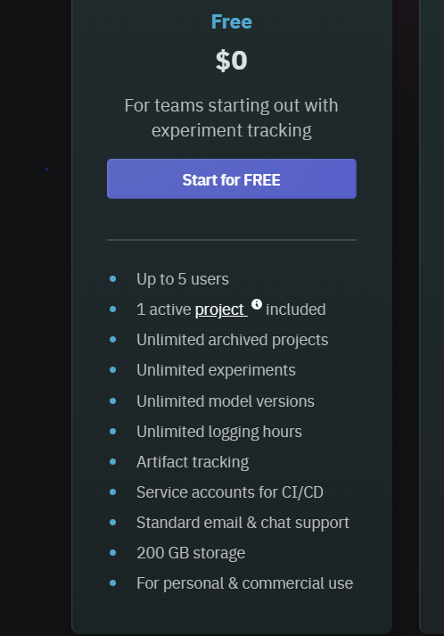
With the default plan
Neptune also provide collaboration among more than 5 people and also more storage, you can also store your data in your infrastructure but not in the neptune server.
But with the pricing plan 😭.

Slide 44
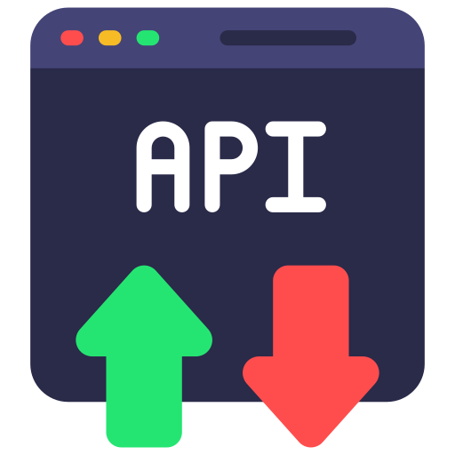


Download data
With the uploaded metadata on Neptune
Can be fetched by API calls
Can be downloaded directly from the website
With the visualized data: charts, comparing
Picture file (PNG)
csv file.

Slide 45
04
POPULARITY & CASES

Slide 46


ACADEMIC
INDUSTRY

Slide 47

ACADEMIC
INDUSTRY
—
RESEARCH EXPERIMENT TRACKING
Reproducibility
Collaboration
Comparison and Analysis
—
EDUCATIONAL TOOL

Slide 48

ACADEMIC
IMPROVED MODEL DEVELOPMENT WORDKFLOW
Faster development
Enhanced collaboration
Efficient model versoning & management
INDUSTRY
REPRODUCIBLE & RELIABLE ML PIPELINES

Slide 49
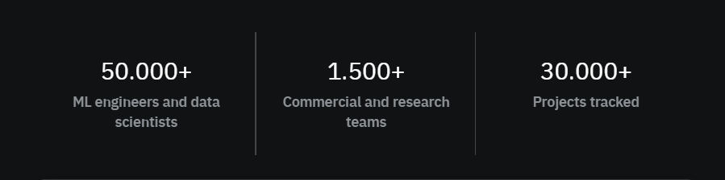
POPULARITY

Slide 50
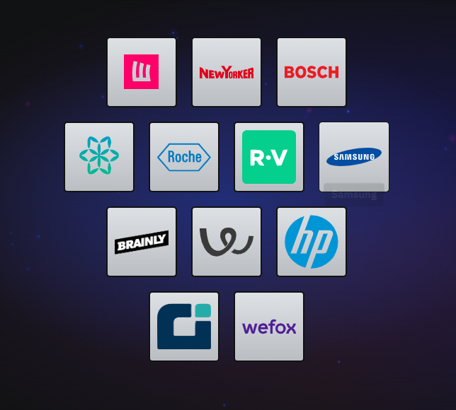

POPULARITY
Customers using Neptune for ML experiment.

Slide 51
05
COMPARISON

Slide 52


mlflow.org
wandb.ai

Slide 53






General capabilities
Neptune
WandB
Mlflow
LIMITED

Slide 54
Experiment tracking
Neptune
Log and display metadata
Log and display metadata
Comparing experiments
WandB
Organizing & Searching
Collaboration and knowledge sharing
mlflow
Reproductivity & Traceability

Slide 55
MODEL REGISTRY
Neptune
WandB
mlflow
- For model searching: can search by metadata/artifacts used to create it, by date, by user, by production stage…
- Don’t provide environment versions and explanations for model versioning.
- Don’t provide model searching.
- For model searching: can only search by registered models and active models.

Slide 56
06
DEMO

Slide 57
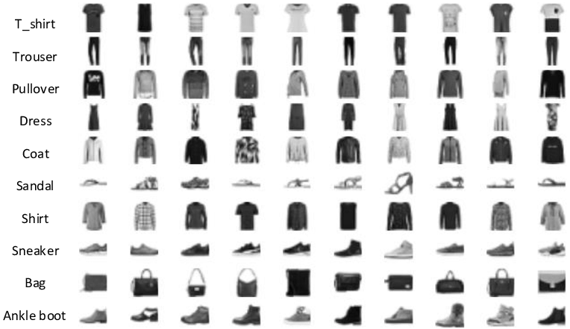
Fashion MNIST

Slide 58

NEURAL NETWORK

Slide 59

Q & A

Slide 60
THANKS FOR LISTENING

Slide 61
Web App – Data versioning
Logging experiment and model training metadata that happens during machine learning run.
Metrics, hyperparameters, learning curves, training code and configuration files.
Predictions (images, tables, etc.), diagnostic charts (confusion matrix, ROC curve, etc.)
Console and hardware logs, model binary or location to your model asset.
Dataset versions, links to recorded model training runs and experiments.
Who trained the model? Model descriptions and notes.
artifact metadata such as: dataset hash, preview the dataset/prediction (head of the table, snapshot of the image folder), description, feature column names (for tabular data)...

Slide 62
Web Application – Experiment tracking
All the logged metadata can be used for experiment tracking that helps to organize your machine learning experimentation in a single place by:
Metrics, parameters, images, and other machine learning metadata can be logged and displayed.
Organizing charts, search, group, and compare experiments with no effort.
Experiments can be visualized and debugged in real-time.
You are sharing results with your team by sending a persistent link.
Querying experiment metadata programmatically.

Slide 63
Web Application – Model registry
Storing your model in a central model registry and making it repeatable and traceable. You may version, save, organize, and query models from model development through deployment. Model registry can be used for a variety of purposes, including:
Know precisely how every model is built.
Record dataset, codes, parameters, model binaries, and more for every training run.
The test set prediction previews and model explanations.
Get back to every model building metadata even months after.
Share models with your team and access them programmatically.

